Slide 1
ASP .Net

Slide 2
Enabling Objectives
After completing this module, you will be able to explain about the basics of ASP.Net

Slide 3
Key Topics
Introduction to Web-Programming and Working with ASP.NET
Building ASP.NET pages
Performing Data Access
Building ASP.NET Application
Web services

Slide 4
Introduction to Web-Programming and Working with ASP.NET

Slide 5
Web Applications
Any application which is based on WWW (World Wide Web) architecture is called a Web application.
Web applications are multi-tiered applications.
The minimal requirements of Web applications are:
-Browser (Internet Explorer, Mozilla, Netscape, and so on)
-Web Server (IIS, Tomcat)
-Network (Internet/Intranet)

Slide 6
Web Applications
The .NET Framework is a managed execution environment that provides a variety of services to its running applications.
XML, SOAP, and HTTP - open platforms used in Web Application development.
Web Page can be Static or Dynamic.

Slide 7
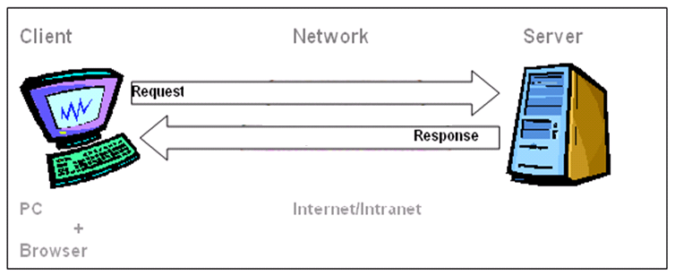
Web Application Architecture
Client-Server Architecture:
There can be multiple clients connected to a single server for the application hosted in the server via a network.

Slide 8
Part of the Dot Net Framework
ASP.NET is part of the Microsoft.NET framework.
Visual Studio is the recommended tool for developing ASP.NET applications.
Visual Studio is multi-targeted which allows to create applications against the ASP.NET 2.0,3.5,4.0,4.5,4.7 frameworks.
To build an ASP.NET page, an application should take advantage of the features of the .NET Framework.
ASP.NET Framework consists of two parts:
-Framework Class Library
-Common Language Runtime [CLR]

Slide 9
ASP.Net and its Framework

Slide 10
What is ASP?
Microsoft introduced ASP (Active Server Pages) in November 1996.
ASP offered the efficiency of ISAPI applications
An ASP file is just the same as an HTML file
An ASP file can contain text, HTML, XML, and scripts
Scripts in an ASP file are executed on the server
An ASP file has the file extension “.asp”
Notes:
Since 1995, Microsoft has been constantly working to shift its focus from Windows-based platforms to the Internet.
As a result, Microsoft introduced ASP (Active Server Pages) in November 1996.
ASP offered the efficiency of ISAPI applications along with a new level of simplicity that made it easy to understand and use.
However, ASP script was an interpreted script and consisted unstructured code and was difficult to debug and maintain.

Slide 11
What is ASP.NET?
.NET Application
.NET Framework
Operating System + Hardware
Notes:
ASP.NET is a new ASP generation.
It is not compatible with Classic ASP, but ASP.NET may include Classic ASP.
ASP.NET has better language support, a large set of user controls, XML-based components, and integrated user authentication.
When a browser requests an ASP.NET file, the ASP.NET engine reads the file, compiles and executes the scripts in the file, and returns the result to the browser as plain HTML.

Slide 12
Framework, Languages, And Tools
VB
VC++
VC#
JScript
…
Visual Studio .NET
Common Language Specification
ASP.NET: Web Services
and Web Forms
Windows Forms
ADO.NET: Data and XML
Base Class Library
Common Language Runtime
Notes:
The .NET framework exposes numerous classes to the developer. These classes allow the development of rich client applications and Web based applications alike. In the above slide these classes have been divided into 4 areas.
ASP.NET provides the core Web infrastructure such as Web Forms for UI based development and Web Services for programmatic interface development,
User interface development on the Windows platform can be done using Windows Forms
ADO.NET and XML provide the functionality for data access.
Finally, the core base classes provide infrastructure services such as security, transaction management etc.

Slide 13
Need for ASP.NET
ASP.NET is built into this framework, we can create ASP.NET applications using any of the built-in languages.
Unlike ASP, ASP.NET uses the Common Language Runtime (CLR) provided by the .NET Framework.
This CLR manages execution of the code we write.
ASP.NET code is a compiled CLR code instead of interpreted code (ASP).
CLR also allows objects written in different languages to interact with each other.

Slide 14
Difference between ASP.NET and ASP
ASP.NET | ASP
Have a code behind file which contains all event handling code. | Does not have such facility to separate programming logic from design.
Inherit the class written in code behind. | Does not have the concept of inheritance.
Use full fledged programming language. | Use scripting language.
ASP.Net web applications are configurable (Web.config). | ASP applications are not.
Use custom controls through the @register directive. | Does not have @register directive
ASP.Net web forms have ADO.Net which supports XML integration and integration of data from two or more data sources. | While ASP has ADO which is a simple COM objects with limited facilities.

Slide 15
Features of ASP.NET
Visual Web Developer
ASP.NET Web Sites and ASP.NET Web Application Projects
ASP.NET API Reference
Page and Controls Framework
ASP.NET Compiler
Security Infrastructure and State-Management Facilities
Notes:
Refer msdn site for detailed info.
http://msdn.microsoft.com/en-us/library/4w3ex9c2.aspx

Slide 16
Internet Information Services - IIS
IIS is a web server that runs on the Microsoft platform for Windows OS
It is used to host web applications
Any request for a site hosted on IIS is first received by it, checked if there is a matching web application hosted. If a web application exists, then the request is routed to it for the appropriate web page to be served
Visual studio framework provides inbuilt set up for a local IIS server that gets initialized and runs automatically on running the application

Slide 17
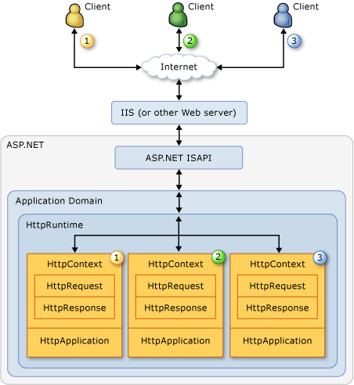
ASP.NET Application Life Cycle
User requests an application resource from the Web server.
ASP.NET receives the first request for the application.
ASP.NET core objects are created for each request.
An HttpApplication object is assigned to the request
The request is processed by the HttpApplication pipeline.
Notes:
Step 1:User requests an application resource from the Web server.
The life cycle of an ASP.NET application starts with a request sent by a browser to the Web server (for ASP.NET applications, typically IIS). ASP.NET is an ISAPI extension under the Web server. When a Web server receives a request, it examines the file-name extension of the requested file, determines which ISAPI extension should handle the request, and then passes the request to the appropriate ISAPI extension. ASP.NET handles file name extensions that have been mapped to it, such as .aspx, .ascx, .ashx, and .asmx.
Step 2:ASP.NET receives the first request for the application
When ASP.NET receives the first request for any resource in an application, a class named ApplicationManager creates an application domain. Application domains provide isolation between applications for global variables and allow each application to be unloaded separately. Within an application domain, an instance of the class named HostingEnvironment is created, which provides access to information about the application such as the name of the folder where the application is stored.
Step 3:ASP.NET core objects are created for each request
After the application domain has been created and the HostingEnvironment object instantiated, ASP.NET creates and initializes core objects such as HttpContext, HttpRequest, and HttpResponse. The HttpContext class contains objects that are specific to the current application request, such as the HttpRequest and HttpResponse objects. The HttpRequest object contains information about the current request, including cookies and browser information. The HttpResponse object contains the response that is sent to the client, including all rendered output and cookies.
Step 4:ASP.NET core objects are created for each request.
After all core application objects have been initialized, the application is started by creating an instance of the HttpApplication class. If the application has a Global.asax file, ASP.NET instead creates an instance of the Global.asax class that is derived from the HttpApplication class and uses the derived class to represent the application.
Step 5:The request is processed by the HttpApplication pipeline.
The following events are executed by the HttpApplication class while the request is processed. The events are of particular interest to developers who want to extend the HttpApplication class.
Validate the request, which examines the information sent by the browser and determines whether it contains potentially malicious markup. For more information, see ValidateRequest and Script Exploits Overview.
Perform URL mapping, if any URLs have been configured in the UrlMappingsSection section of the Web.config file.
Raise the BeginRequest event.
Raise the AuthenticateRequest event.
Raise the PostAuthenticateRequest event.
Raise the AuthorizeRequest event.
Raise the PostAuthorizeRequest event.
Raise the ResolveRequestCache event.
Raise the PostResolveRequestCache event.
Based on the file name extension of the requested resource (mapped in the application's configuration file), select a class that implements IHttpHandler to process the request. If the request is for an object (page) derived from the Page class and the page needs to be compiled, ASP.NET compiles the page before creating an instance of it.
Raise the PostMapRequestHandler event.
Raise the AcquireRequestState event.
Raise the PostAcquireRequestState event.
Raise the PreRequestHandlerExecute event.
Call the ProcessRequest method (or the asynchronous version IHttpAsyncHandler.BeginProcessRequest) of the appropriate IHttpHandler class for the request. For example, if the request is for a page, the current page instance handles the request.
Raise the PostRequestHandlerExecute event.
Raise the ReleaseRequestState event.
Raise the PostReleaseRequestState event.
Perform response filtering if the Filter property is defined.
Raise the UpdateRequestCache event.
Raise the PostUpdateRequestCache event.
Raise the EndRequest event.
Raise the PreSendRequestHeaders event.
Raise the PreSendRequestContent event.
For more information:
http://msdn.microsoft.com/en-us/library/ms178473(v=vs.100).aspx

Slide 18
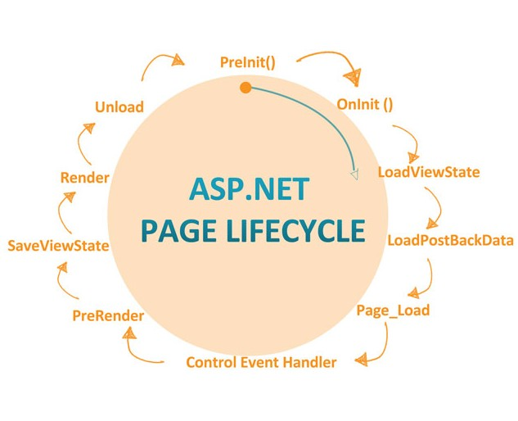
ASP.NET Page Life Cycle
Page request
Start
Initialization
Load
Postback event handling
Rendering
Unload
Notes:
Page request
The page request occurs before the page life cycle begins. When the page is requested by a user, ASP.NET determines whether the page needs to be parsed and compiled (therefore beginning the life of a page), or whether a cached version of the page can be sent in response without running the page.
Start
In the start stage, page properties such as Request and Response are set. At this stage, the page also determines whether the request is a postback or a new request and sets the IsPostBack property. The page also sets the UICulture property.
Initialization
During page initialization, controls on the page are available and each control's UniqueID property is set. A master page and themes are also applied to the page if applicable. If the current request is a postback, the postback data has not yet been loaded and control property values have not been restored to the values from view state.
Load
During load, if the current request is a postback, control properties are loaded with information recovered from view state and control state.
Postback event handling
If the request is a postback, control event handlers are called. After that, the Validate method of all validator controls is called, which sets the IsValid property of individual validator controls and of the page. (There is an exception to this sequence: the handler for the event that caused validation is called after validation.)
Rendering
Before rendering, view state is saved for the page and all controls. During the rendering stage, the page calls the Render method for each control, providing a text writer that writes its output to the OutputStream object of the page's Response property.
Unload
The Unload event is raised after the page has been fully rendered, sent to the client, and is ready to be discarded. At this point, page properties such as Response and Request are unloaded and cleanup is performed.
pre-init : all controls created during the design time are initialized with the default values. On-init: Here we can read the control Properties where as you cannot read the control values. Load view state: This event gets triggers only if the page is post back (i.e. ispageback==true). loads all the controls which are viewstate enabled LoadPostBackData: This event also gets triggered only if the page is post-back. PageLoad: control properties are loaded with information recovered from view state and control state. Control event handlers: These events to handle specific control events, PreRender: This event is triggered recursively for each child control in the page SaveViewState: Raised after view state and control state have been saved for the page and for all controls Render : This method writes out the control’s markup to send to the browser. unload : This event does the final cleanup for controls, used in the page
For more details:
http://msdn.microsoft.com/en-us/library/ms178472(v=vs.100).aspx

Slide 19
Recap
Recall the ASP.Net Page lifecycle events

Slide 20
Building ASP.NET pages

Slide 21
ASP.NET Web Forms
Web Forms are pages that your users request through their browser and that form the user interface (UI) that give your web applications their look and feel.
These pages are written using a combination of
HTML controls, server controls, and server code.
When users request a page, it is compiled and executed on the server, and then it generates the HTML markup that the browser can render.

Slide 22
ASP.NET Controls
Types of ASP.NET Controls.
ASP.NET Web Server Control
- They are objects on ASP.NET Web pages that run when the page is requested and that render markup to the browser.
ASP.NET User Control
- They are own custom, reusable controls using the same techniques you use for creating ASP.NET Web pages.
ASP.NET Web Part Control
- They are an integrated set of controls for creating Web sites
Notes:
ASP.NET Web Server Control :
ASP.NET Web server controls are objects on ASP.NET Web pages that run when the page is requested and that render markup to the browser.
Many Web server controls are similar to familiar HTML elements, such as buttons and text boxes. Other controls encompass complex behavior, such as a calendar controls, and controls that you can use to connect to data sources and display data
ASP.NET User Control:
In addition to using Web server controls in your ASP.NET Web pages, you can create your own custom, reusable controls using the same techniques you use for creating ASP.NET Web pages. These controls are called user controls.
A user control is a kind of composite control that works much like an ASP.NET Web page—you can add existing Web server controls and markup to a user control, and define properties and methods for the control. You can then embed them in ASP.NET Web pages, where they act as a unit.
ASP.NET Web Part Control:
ASP.NET Web Parts controls are an integrated set of controls for creating Web sites that enable end users to modify the content, appearance, and behavior of Web pages directly in a browser.

Slide 23
ASP.NET Server Controls
Server controls are specifically designed to work with Web Forms pages.
When you create Web Forms pages, you can use these types of controls:
HTML server controls
Web server controls
- Validation controls
User controls
Notes:
Details on the controls
HTML server controls : HTML elements exposed to the server so you can program them. HTML server controls expose an object model that maps very closely to the HTML elements that they render.
Note : An HTML element is converted to a HTML server control by the addition of the attribute RUNAT="SERVER".
Web server controls : Controls with more built-in features than HTML server controls. Web server controls include not only form-type controls such as buttons and text boxes, but also special-purpose controls such as a calendar. Web server controls are more abstract than HTML server controls in that their object model does not necessarily reflect HTML syntax. The Validation controls also come under web server controls being used for data validation. Controls that incorporate logic to allow you to test a user's input. You attach a validation control to an input control to test what the user enters for that input control.
Validation controls are provided to allow you to check for a required field, to test against a specific value or pattern of characters, to verify that a value lies within a range, and so on.
User controls : Controls that you create as Web Forms pages. You can embed Web Forms user controls in other Web Forms pages, which is an easy way to create menus, toolbars, and other reusable elements.

Slide 24
HTML Server Controls
The HTML server controls are basically the standard HTML controls enhanced to enable server side processing.
HTML controls act as the HTML server controls with runat=”server” attribute or value pair.
Examples:
<input id="Name" type=“text” size=40 runat="server">
<input id="Enter" type=“submit” value="Enter“ runat="server">
Click <a id="Anchor1" runat="server“ href="more.html">
More </a> to see the next page.

Slide 25
HTML Server Controls: Types
Navigation – HtmlAnchor
Button - HtmlButton
Forms - HtmlForm
Head - HtmlHead
Image Controls
Commands Controls
Notes:
Navigation - HtmlAnchor: Creates a Web navigation link
Button - HtmlButton: Allows programmatic access to the HTML <button> tag on the server
Forms - HtmlForm: Defines HTML form and the values of controls within the form are posted to the server when the form is submitted.
Head - HtmlHead: Provides programmatic access to the HTML <head> element on the server and the element is a container for additional information about the page
Image Controls: Displays an Image
Commands Controls: This is a button control

Slide 26
HTML Server Controls: Types
File transfer – HtmlInputFile
Information storage Text Hidden - HtmlInputHidden
Checkbox - HtmlInputCheckBox
Radio Button - HtmlInputRadioButton
Title - HtmlTitle
DIV, TABLE, ROW, CELL
Notes:
Input Controls:
Serves as the abstract base class that defines the methods, properties, and events common to all HTML input controls, such as the
<input type=text> , <input type=submit> , and <input type= file> elements.
This class is inherited by other classes like HtmlInputText, HtmlInputButton, HtmlInputRadioButton, HtmlInputCheckBox, HtmlInputImage, HtmlInputHidden, and HtmlInputFile classes.
File transfer - HtmlInputFile: This uses the HtmlInputFile server control to handle uploading binary or text files from a browser client to the server
Information storage Text Hidden - HtmlInputHidden: You can use the HtmlInputHidden control to embed information that is hidden from the user within a <form> element. This information is sent when the Web page is posted back to the server. This stores state information for a form.
Checkbox - HtmlInputCheckBox:
Creates a box that users can click to turn on and off. The Checkbox control includes a label.
Allows programmatic access to the HTML <input type= checkbox> element on the server Radio Button - HtmlInputRadioButton:
To select one item from a short list of fixed options
Allows programmatic access to the HTML <input type= radio> element on the server
Title - HtmlTitle: Use the HtmlTitle class to programmatically specify the HTML <title> element of a Web Forms page
DIV:
DIV defines HTML element and specifies a container that renders HTML.
If you convert a HTML DIV element to an ASP.NET server control, then it is created as an instance of the HtmlGenericControl class.
ASP.NET server controls that render as a DIV element are called as panel.
TABLE, ROW, CELL
HtmlTable: Creates a table. <table></table>.
HtmlTableRow: Creates an individual row within a table. <tr></tr>.
HtmlTableCell: Creates an individual cell within a table row. <td></td>.

Slide 27
Validation Controls
Used for frequently used validations
List of validation controls
RequiredFieldValidator
RangeValidator
CompareValidator

Slide 28
Building ASP.NET Application

Slide 29
State Management

Slide 30
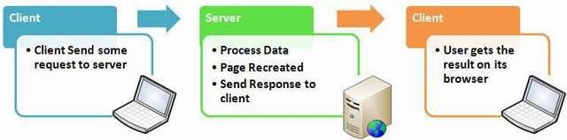
Need of State Management
Web is Stateless.
It means a new instance of the web page class is re-created each time the page is posted to the server.
As we all know HTTP is a stateless protocol, it cannot hold the client information on page.
Pages are destroyed and re-created with each round trip to the server; therefore, page information will not exist beyond the life cycle of a single page.
Notes:
For example suppose you have a page contain one TextBox and Button control. Now, if you enter some text in TextBox and click the Button then text does not appear after the Postback since Page is recreated on round trip.
As mentioned the pages are recreated before its comes to clients and happened for each and every request. So it is a big issue to maintain the state of the page and information for a web application. That is the reason to start concept of State Management.

Slide 31
Different types of State Management
State Management
Client Side
Server Side
View State
Session
Hidden Field
Application
Cookies
Profile Properties
Control State
Database Support
Query String
Notes:
View State
The ViewState property provides a dictionary object for retaining values between multiple requests for the same page. This is the default method that the page uses to preserve page and control property values between round trips.
When the page is processed, the current state of the page and controls is hashed into a string and saved in the page as a hidden field, or multiple hidden fields if the amount of data stored in the ViewState property exceeds the specified value in the MaxPageStateFieldLength property. When the page is posted back to the server, the page parses the view-state string at page initialization and restores property information in the page.
You can store values in view state as well. For more information on using View State, see ASP.NET View State Overview.
Hidden Fields
ASP.NET allows you to store information in a HiddenField control, which renders as a standard HTML hidden field. A hidden field does not render visibly in the browser, but you can set its properties just as you can with a standard control. When a page is submitted to the server, the content of a hidden field is sent in the HTTP form collection along with the values of other controls. A hidden field acts as a repository for any page-specific information that you want to store directly in the page.
Cookies
A cookie is a small amount of data that is stored either in a text file on the client file system or in-memory in the client browser session. It contains site-specific information that the server sends to the client along with page output. Cookies can be temporary (with specific expiration times and dates) or persistent.
Control State
Sometimes you need to store control-state data in order for a control to work properly. For example, if you have written a custom control that has different tabs that show different information, in order for that control to work as expected, the control needs to know which tab is selected between round trips. The ViewState property can be used for this purpose, but view state can be turned off at a page level by developers, effectively breaking your control. To solve this, the ASP.NET page framework exposes a feature in ASP.NET called control state.
The ControlState property allows you to persist property information that is specific to a control and cannot be turned off like the ViewState property.
Query Strings
A query string is information that is appended to the end of a page URL.
Query strings provide a simple but limited way to maintain state information. For example, they are an easy way to pass information from one page to another, such as passing a product number from one page to another page where it will be processed. However, some browsers and client devices impose a 2083-character limit on the length of the URL.
Application State
ASP.NET allows you to save values using application state — which is an instance of the HttpApplicationState class — for each active Web application. Application state is a global storage mechanism that is accessible from all pages in the Web application. Thus, application state is useful for storing information that needs to be maintained between server round trips and between requests for pages. For more information, see ASP.NET Application State Overview.
Application state is stored in a key/value dictionary that is created during each request to a specific URL. You can add your application-specific information to this structure to store it between page requests.
Once you add your application-specific information to application state, the server manages it.
Session State
ASP.NET allows you to save values by using session state — which is an instance of the HttpSessionState class — for each active Web-application session. Session state is similar to application state, except that it is scoped to the current browser session. If different users are using your application, each user session will have a different session state. In addition, if a user leaves your application and then returns later, the second user session will have a different session state from the first.
Session state is structured as a key/value dictionary for storing session-specific information that needs to be maintained between server round trips and between requests for pages. You can use session state to accomplish the following tasks:
Uniquely identify browser or client-device requests and map them to an individual session instance on the server.
Store session-specific data on the server for use across multiple browser or client-device requests within the same session.
Raise appropriate session management events. In addition, you can write application code leveraging these events.
Once you add your application-specific information to session state, the server manages this object. Depending on which options you specify, session information can be stored in cookies, on an out-of-process server, or on a computer running Microsoft SQL Server.
Profile Properties
ASP.NET provides a feature called profile properties, which allows you to store user-specific data. This feature is similar to session state, except that the profile data is not lost when a user's session expires. The profile-properties feature uses an ASP.NET profile, which is stored in a persistent format and associated with an individual user. The ASP.NET profile allows you to easily manage user information without requiring you to create and maintain your own database.
For more information on State management techniques, refer below link:
http://msdn.microsoft.com/en-us/library/75x4ha6s.ASPX

Slide 32
Server Side State Management-Session
ASP.NET session state enables you to store and retrieve values for a user as the user navigates ASP.NET pages in a Web application.
HTTP is a stateless protocol.
This means that a Web server treats each HTTP request for a page as an independent request.
The server retains no knowledge of variable values that were used during previous requests.

Slide 33
Server Side State Management-Session
ASP.NET session state identifies requests
from the same browser during a limited time window as a session,
and provides a way to persist variable values for the duration of that session.
By default, ASP.NET session state is enabled for all ASP.NET applications.

Slide 34
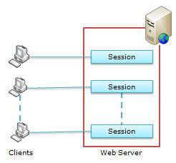
Server Side State Management-Session
Session provides a facility to store information on server memory. It can support any type of object to store along with our own custom objects.
For every client, session data is stored separately, which means session data is stored on a per client basis.

Slide 35
Server Side State Management-Session
ASP.NET uses an 120 bit identifier to track each session.
This is secure enough and can't be reverse engineered.
When a client communicates with a server,
only the session ID is transmitted between them.
When the client requests for data,
ASP.NET looks for the session ID and retrieves the corresponding data.

Slide 36
Server Side State Management-Session
This is done in the following steps:
Client hits the web site and information is stored in the session.
Server creates a unique session ID for that client and stores it in the Session State Provider.
The client requests for some information with the unique session ID from the server.

Slide 37
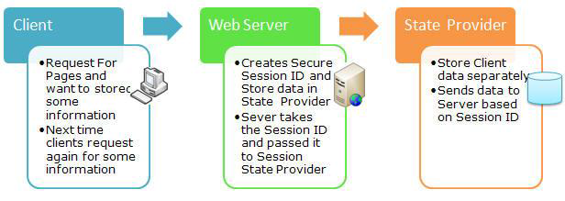
Server Side State Management-Session
Server looks in the Session Providers and retrieves the serialized data from the state server and type casts the object.
Take a look at the pictorial flow -

Slide 38
Server Side State Management-Session
To manage a session, ASP.NET provides two events written in Global.asax in the root directory of the project.
session_start
session_end
Session_Start:
Is raised every time a new user makes a request without a session ID.
Session_End:
Is raised when session ends either because of a time out expiry or explicitly by using Session.Abandon(). The Session_End event is raised only in the case of In proc mode not in the state server and SQL Server modes.

Slide 39
Client Side State Management- View State
Web Forms pages provide the ViewState property as a built-in structure for automatically retaining values between multiple requests for the same page. View state is maintained as a hidden field in the page.
You can use view state to store your own page-specific values across round trips when the page posts back to itself.
We can set View State on/off for each control using EnableViewState property.
By default, EnableViewState property will be set to true
We can also disable View State for the entire page by adding EnableViewState = false to @page directive.

Slide 40

Client Side State Management- Hidden Field
You can store page-specific information in a hidden field on your page as a way of maintaining the state of your page.
If you use hidden fields, it is best to store only small amounts of frequently changed data on the client.
Note- If you use hidden fields, you must submit your pages to the server using the HTTP POST method rather than requesting the page via the page URL (the HTTP GET method).

Slide 41
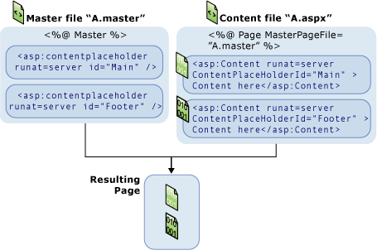
ASP.NET Master Pages

Slide 42
ASP.Net Web User Control
ASP.Net provides feature for web control reusability
WebUserControl is a type of control in Visual studio that can be created and placed it in any web page
It has .ascx extension
Reference link: https://www.tutorialspoint.com/asp.net/asp.net_custom_controls.htm

Slide 43
Performing Data Access

Slide 44
DataBound Controls

Slide 45
DataBound Controls
Represent the data in the database.
Provides option to bind the entire class object to control.
Format of display is different among these controls.
Hierarchy of objects can be maintained and can be represented as Parent Child relationship.
DataMember can be defined.
Advance implementation can also be done
Notes:
DataMember can be defined which is a mapping of the attributes available in the class object bound to datasource
Advance implementation can also be done with the help of INotifyChanged interface which will in turn update the data back to the object automatically

Slide 46
Types of DataBound Controls
Data Bound Control is of three types. They are mentioned below:
List controls.
Tabular DataBound controls.
Hierarchical DataBound controls.

Slide 47
List Controls
List controls are the basic data bound control.
They have advanced facility of data binding through object with a option to specify the data member.
List controls can mainly have the Display value and the code value behind it.
Both display and code values can be bound to the list controls and it can be retrieved directly by just accessing the item inside the control.

Slide 48
Types of List Controls
List controls available with ASP.NET 4.7 are as follows :
Check Box List.
Bulleted List.
Dropdown List.
List Box.
Radio Button List.
All five controls inherit from the same base ListControl class.
This means that all these controls share a core set of properties and methods.
Notes:
Check Box List: Displays a list of check boxes. Multiple check boxes in the list can be selected.
Bulleted List: Displays a bulleted list of items. Each item can be displayed as text, a link button, or a hyperlink.
Dropdown List: Displays a drop-down list. Only one item in the drop-down list can be selected. Drop down item can have the code value for its unique representation.
List Box: Displays a list box. You can configure this control so that only one item in the list can be selected or multiple items can be selected.
Radio Button List: Displays a list of radio buttons. Only one radio button can be selected.

Slide 49
Tabular DataBound Controls
Gives a clean presentation of the data in database.
It has various options to decorate and display.
Supports object binding and direct connection with database.
Can be made editable, hence record can be updated inside the control, clicking “OK” updates back into database.
Provides additional features to sort and perform paging of the data.
Notes:
Tabular data bound controls give a clean presentation of the data in the database. It has various options to decorate the display and satisfy the need of the customers.
Tabular data bound controls supports object binding and also direct connection with database so that add , update and delete can be reflected immediately into the database.
Tabular data bound controls can also be made editable and hence updating of records can happen directly inside the control and on click of “ok” data can be updated into the database.
Tabular data controls has additional features to sort and perform paging of the data.

Slide 50
Types of Tabular DataBound Controls
DataBound controls can be divided in 2 main groups:
Single data item display:
DetailsView
FormView
Data list controls:
GridView
DataList
Repeater
ListView
Notes:
Single data item display: Controls that show only individual records at a time
DetailsView: It displays a single data item in an HTML table. For example, the DetailsView control can be used to display a single record from the Movies database table. This control enables you to display, page, edit, and add data.
FormView: It uses a template to display a single data item. Unlike the DetailsView, a FormView enables you to lay out a form by using templates.
Data view controls: Controls that show collection of records
GridView: Displays a set of data items in an HTML table. This control enables you to display, sort, page, select, and edit data.
DataList: Displays a set of data items in an HTML table. Unlike the GridView control, more than one data item can be displayed in a single row.
Repeater: Displays a set of data items using a template. Unlike the GridView and DataList controls, a Repeater control does not automatically render an HTML table.
ListView: Displays a set of data items using a template. Unlike the Repeater control, the ListView control supports sorting, paging, and editing database data.

Slide 51
DataSource Controls

Slide 52
DataSource Controls
Makes Data binding simple.
Are powerful and acts as a middle layer between data bound controls and the database
Data from the database can be fetched through GUI settings rather than code.

Slide 53
DataSource Controls
Encapsulates the following features
Establishing connection.
Selection of data
Perform Paging of data, sorting of data
Manipulation of data

Slide 54
Types of DataSource Controls
SqlDataSource:
LinqDataSource
AccessDataSource
ObjectDataSource
XmlDataSource
SiteMapDataSource
Notes:
LinqDataSource: Represents a LINQ to SQL query.
AccessDataSource: Represents data retrieved from a Microsoft Access database.
ObjectDataSource: Represents data retrieved from a business object.
XmlDataSource: Represents data retrieved from an XML document.
SiteMapDataSource: Represents data retrieved from a Site Map Provider. A Site Map Provider represents the page and folder structure of a website.

Slide 55
Databinding
Declarative Databinding
Binding of Data Bound control to a Data Source control.
ASP.Net Framework handles all details of when to retrieve the data.
Programmatic Databinding
Is used in situations where the data bind is not easily represented in the existing Data Source controls.
Can be done by using Data Source property and the DataBind() method which is available for every Data Bound control.

Slide 56
Programmatic Databinding
For GridView Control when you call the DataBind() method,
The GridView control retrieves its data from the data source.
The GridView is bound to its data source only when the page is requested for the first time.
No rebinding of Data –
Gridview uses View State to remember data.
Page.IsPostBack property is used to find if page has been posted back to the server.

Slide 57
Using Templates
The Repeater, DataList, ListView, and FormView controls all require you to use templates.
The GridView, DetailsView, and Menu controls also support templates only to display the values
A template can contain HTML, data binding expressions, other controls.
The template includes the data binding expressions:
<%# Eval(“Field1”) %>
<%# Eval(“Field2”) %>
Field1 and Field2 are column name

Slide 58
Using Databinding Expressions
A data binding expression
is a special type of expression that is not evaluated until runtime.
Is marked in a page by wrapping the expression in opening <%# and closing %> brackets.
isn’t evaluated until a control’s data binding event is raised.
When you bind a Data Bound control to a DataSource control declaratively, this event is raised automatically.
When you bind a Data Source control to a data source programmatically, the data binding event is raised when you call the DataBind() method.
Data binding expressions call the Eval() method. The Eval() method is a protected method of the Page class.

Slide 59
Using Databinding Expressions
Behind the scenes, the Page.Eval() method calls the static (shared) DataBinder.Eval() method.
If you want to be verbose, instead of using the Eval() method, you could use the below two expressions.
You can call other methods than the Eval() method in a DataBinding expression.
<%# DataBinder.Eval(Container.DataItem, “Title”) %>
<%# DataBinder.Eval(Container.DataItem, “DateReleased”, “{0:D}” ) %>

Slide 60
Strongly Typed Data Controls

Slide 61
Strongly Typed Data Controls
In ASP.NET 4.5 onwards, Web Forms includes some improvements for working with data. The first improvement is strongly typed data controls.
For Web Forms controls in previous versions of ASP.NET, you display a data-bound value using Eval and a data-binding expression:
<ul>
<asp:Repeater runat="server" ID="customers">
<ItemTemplate>
<li>
First Name: <%# Eval("FirstName")%><br />
Last Name: <%# Eval("LastName")%><br />
</li>
</ItemTemplate>
</asp:Repeater> </ul>

Slide 62
Strongly Typed Data Controls
For two-way data binding, you use Bind:
<asp:FormView runat="server" ID="editCustomer">
<EditItemTemplate>
<div>
<asp:Label runat="server" AssociatedControlID="firstName"> First Name:</asp:Label>
<asp:TextBox ID="firstName" runat="server" Text='<%#Bind("FirstName")%>' />
</div>
<div>
<asp:Label runat="server" AssociatedControlID="lastName">Last Name:</asp:Label>
<asp:TextBox ID="lastName" runat="server" Text='<%#Bind("LastName")%>' />
</div>
<asp:Button runat="server" CommandName="Update"/>
</EditItemTemplate>
</asp:FormView>
Notes:
However, data-binding expressions like this don't support features like IntelliSense for member names, navigation (like Go To Definition), or compile-time checking for these names.
To address this issue, ASP.NET 4.7 adds the ability to declare the data type of the data that a control is bound to. You do this using the new ItemType property. When you set this property, two new typed variables are available in the scope of data-binding expressions: Item and BindItem. Because the variables are strongly typed, you get the full benefits of the Visual Studio development experience.
<asp:FormView runat="server" ID="editCustomer">
<EditItemTemplate>
<div>
<asp:Label runat="server" AssociatedControlID="firstName">First Name:</asp:Label>
<asp:TextBox ID="firstName" runat="server" Text='<%#Bind("FirstName") %>' />
</div>
<div>
<asp:Label runat="server" AssociatedControlID="lastName">Last Name:</asp:Label>
<asp:TextBox ID="lastName" runat="server" Text='<%#Bind("LastName") %>' />
</div>
<asp:Button runat="server" CommandName="Update"/>
</EditItemTemplate>
</asp:FormView>

Slide 63
Model Binding- selecting data
To configure a data control to use model binding to select data-
Set the control's SelectMethod property to the name of a method in the page's code.
The data control calls the method at the appropriate time in the page life cycle and automatically binds the returned data.
There's no need to explicitly call the DataBind method.

Slide 64
Model Binding- selecting data
In the following example, the GridView control is configured to use a method named GetCategories:
<asp:GridView ID="categoriesGrid" runat="server"
ItemType="WebApplication1.Model.Category"
SelectMethod="GetCategories" AutoGenerateColumns="false">
<Columns>
<asp:BoundField DataField="CategoryID" HeaderText="ID" />
<asp:BoundField DataField="CategoryName" HeaderText="Name" />
<asp:BoundField DataField="Description" HeaderText="Description" />
<asp:TemplateField HeaderText="# of Products">
<ItemTemplate>
<%# Item.Products.Count %>
</ItemTemplate>
</asp:TemplateField>
</Columns>
</asp:GridView>

Slide 65
Model Binding- selecting data
You create the GetCategories method in the page's code. For a simple select operation, the method needs no parameters and should return an IEnumerable or IQueryable object.
The following example shows the code for a GetCategories method.
public IQueryable<Category> GetCategories()
{
var db = new Northwind();
return db.Categories.Include(c => c.Products);
}

Slide 66
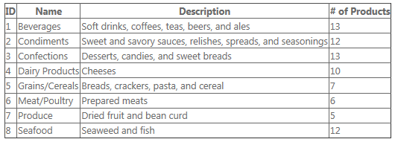
Model Binding- selecting data
When the page runs, the GridView control calls the GetCategories method automatically and renders the returned data using the configured fields

Slide 67
Database Connections

Slide 68
Creating Database Connections
We can use the SqlDataSource control to connect to just about any SQL relational database server.
To connect to data-base server we have two types of providers in Dot Net framework:
Microsoft SQL Server and
other databases such as Oracle.
We can open database connection using the DB-String by the SqlDataSource securely in your web configuration files.

Slide 69
Connecting to Microsoft SQL Server
By default, the SqlDataSource control is configured to connect to Microsoft SQL Server version 7.0 or higher.
ADO.NET is the default provider used by SqlDataSource for Microsoft SQL Server.
SqlDataSource control has a property “ConnectionString” for connecting to Database.
Notes:
Explanation for Connection string
The connection string connects to an instance of SQL Server Express located on the local machine and a database file named MyDatabase.mdf.
The connection string uses Integrated Security (a Trusted Connection) to connect to the local database.
You can use the following connection string to connect to a database located on a remote server.
Data Source=DataServer;Initial ret

Slide 70
Connecting to Microsoft SQL Server
Data Source=DataServer;
Initial Catalog=Northwind;
User ID=webuser; Password=secret
In this database connection string
Connects to SQL Server database located on a remote machine named Data Server
Connects to a database named Northwind.
Uses SQL Standard Security instead of Integrated Security- it contains UserID and Password associated with a SQL Server login.

Slide 71
Connecting to Other Databases
If you need to connect to any database server other than Microsoft SQL Server, then you need to modify the SqlDataSource control’s ProviderName property.
The .NET Framework includes the following providers:
System.Data.OracleClient — when connecting to an Oracle database.
System.Data.OleDb — when connecting to a data source that supports an OLE DB provider.
System.Data.Odbc — when connecting to a data source with an ODBC driver.

Slide 72
Connecting to Other Databases
For performance reasons, you should always use the native ADO.NET provider for a database.
If your database does not have an ADO.NET provider, then you need to use either OLE DB or ODBC to connect to the database.
Almost every database under the sun has either an OLE DB provider or an ODBC driver.

Slide 73
Strategies to improve application performance
Check and reduce database hit
Check the image size and reduce if appropriate
Check EnableViewState value. Set to false if REALLY needed and appropriate

Slide 74
Configuration

Slide 75
Configuration Files
The .NET Framework defines a set of elements to implement configuration settings.
The ASP.NET configuration settings contain elements that control how ASP.NET Web applications behave.
ASP.NET configuration files are XML files. The XML tags and attributes are case-sensitive.
For Web Application, the important configuration files are as follows:
Web.config
Machine.config

Slide 76
Configuration Files Concept
In ASP.NET configuration system, you can configure:
All ASP.NET applications on a server
A single ASP.NET application
Individual pages
Application subdirectories

Slide 77
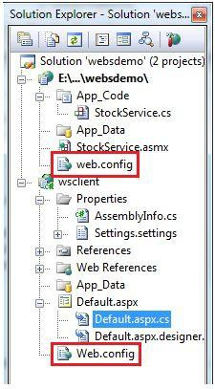
Web.Config
The Web.Config file:
The Web.config is an XML based configuration file for the entire application.
Resides in the application root.
It provides the application wide settings for the entire application.
Multiple web.config files are supported.
Notes:
There can be multiple web.config files in your application (one per each folder in your application)
When you create a new blank solution and select ASP.NET web application, the solution is created with a web.config file at the application's root.

Slide 78
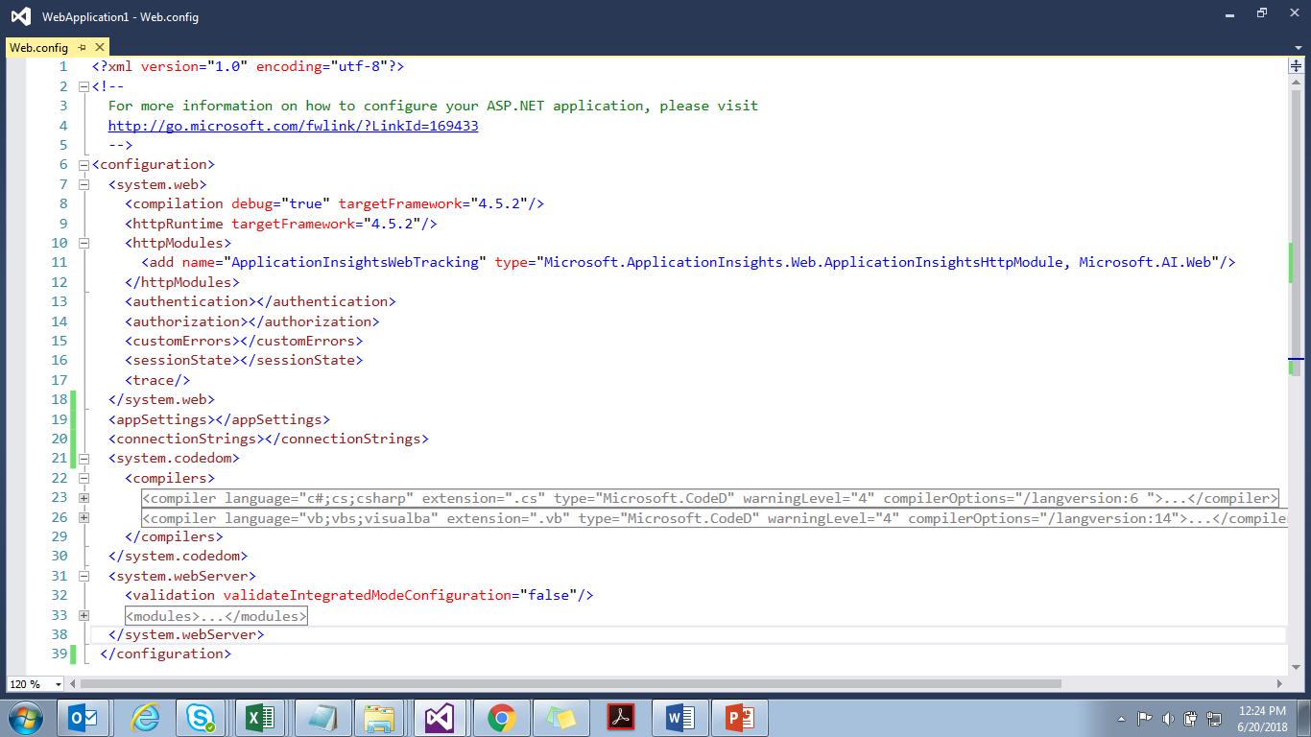
The layout of the web.config file

Slide 79
Web.Config File
Some of the important settings are as follows:
<appSettings> element
<connectionStrings> element
<system.web> element
<authentication> element
<authorization> element
<customErrors> element
<sessionState> element
<trace/> element

Slide 80

Web.Config File
<appSettings>
This element stores custom application configuration information, such as:
file paths
XML Web service URLs
Any information that is stored in the .ini file
key/value pairs for an application

Slide 81

Web.Config File
<customErrors>
This element provides information about custom error messages for an ASP.NET application.

Slide 82
Publish Asp.Net Websites

Slide 83
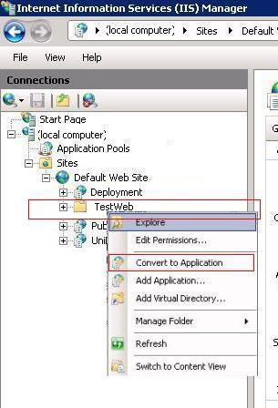
Steps to Publish Asp.Net Websites using IIS
Step 1: From Visual Studio, publish your Web application.
Step 2: Copy the published application folder to "C:\intepub\wwwroot" [default] folder.
Step 3: From RUN - > inetmgr -> OK
Step 4: Select the application, right click
and then Click on
"ConvertToApplication" as shown.

Slide 84
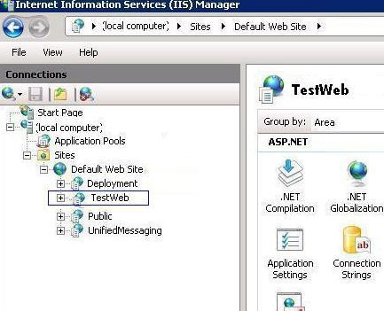
Steps to Publish Asp.Net Websites using IIS
After converting it to application, its icon will be changed and then you can set the property for your web application from the middle pane.

Slide 85
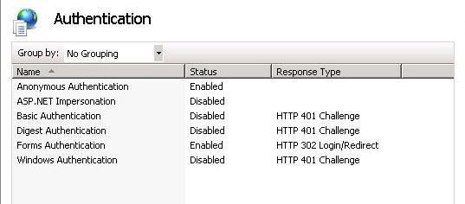
Steps to Publish Asp.Net Websites using IIS
Security Settings can be changed on Authentication Section. By default Setting will be set from the web.config itself.
To change the status, just double click and update status to Enabled to Disabled or Vice Versa.

Slide 86
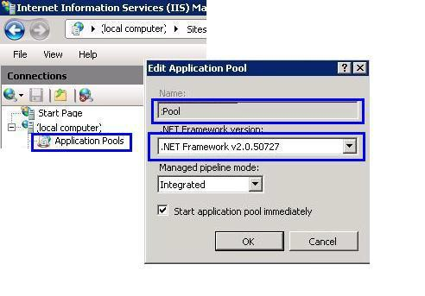
Steps to Publish Asp.Net Websites using IIS
The most important part is to set the Application Pool for your application.
How to Create Application Pool?
Step 1: Right Click on Application Pool and give the name of your pool.
Here, I have given "pool" and select Framework and click on OK:

Slide 87
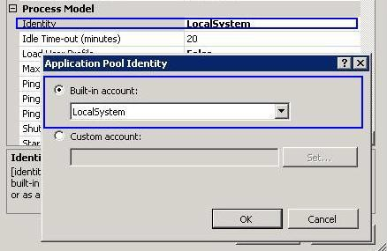
Steps to Publish Asp.Net Websites using IIS
Step 2: If you are writing some thing on the server [may be writes Error Events Logs], you need to change the Pool Identity to Local System. Right click on Pool Identity setting as shown in the following image:
There are three identities of Application Pool:
Network Service
Local Service
Local System
87

Slide 88
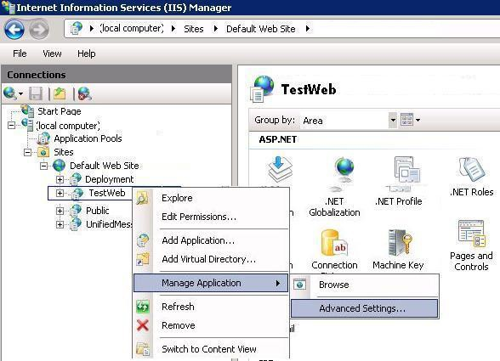
Steps to Publish Asp.Net Websites using IIS
Now, we need to assign the Application Pool to the web application.
Step 1: Right Click on "TestWeb" Application and Select "Advanced Settings":
88

Slide 89
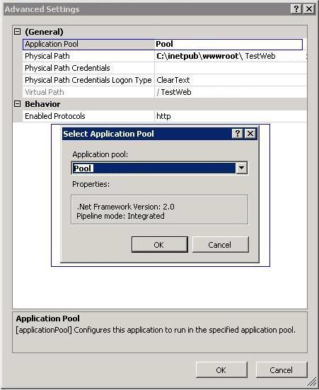
Steps to Publish Asp.Net Websites using IIS
Step 2: Finally assign your created Application Pool "pool" to "TestWeb" Application.
89

Slide 90
Steps to Publish Asp.Net Websites using IIS
Now you can run your application by just typing http://localhost/testweb and it can be accessible on network by IP also!!!!!!!

Slide 91
Authentication & Authorization

Slide 92
What is Authentication & Authorization?
Authentication is the process to check if a user is allowed to access the application or not
Authorization is the process to check the role the user has in the application once the authenticated to access the application

Slide 93
Types of Authentication
Windows authentication
Authentication based on user credential presence on to the Windows Active Directory system
Forms authentication
Custom logic to authenticate user based on Username and password combination
Anonymous authentication
No authentication required to access the application

Slide 94
Forms Authentication
Authenticates by using user defined code.
The code maintains an authentication token in a cookie or in the page URL.
Login page can be created which collects credentials from the user that are authenticated with code.
Application is configured to redirect the requests to login page when users try to access a protected resource, such as a page that requires authentication.
Notes:
In case if user directly tries to load a protected resource.
If the user's credentials are valid, you can call methods of the FormsAuthentication class to redirect the request back to the originally requested resource with an appropriate authentication ticket (cookie). If you do not want the redirection, you can just get the forms authentication cookie or set it. On subsequent requests, the user's browser passes the authentication cookie with the request, which then bypasses the login page.

Slide 95
Forms Authentication Provider
To configure the application for forms authentication specify the below changes in the web.config
<system.web>
<authentication mode="Forms">
<forms loginUrl="Logon.aspx" name=".ASPXFORMSAUTH">
</forms>
</authentication>
<authorization> <deny users="?" /> </authorization>
</system.web>
Notes:
Parameters :
loginUrl Set to "Logon.aspx." Logon.aspx is the URL to use for redirection if ASP.NET does not find an authentication cookie with the request.
name Set to ".ASPXFORMSAUTH". This sets the suffix for the name of the cookie that contains the authentication ticket.
deny element set its users attribute to "?". This specifies that unauthenticated users (represented by "?") are denied access to resources in this application.
In the example the useremail and password are hard coded and verified for easy understanding. The Username and password can also be returned from Database and verified against it.

Slide 96
Forms Authentication Provider
In Code Behind
if ((UserEmail.Text == "jchen@contoso.com")
&& (UserPass.Text == "37Yj*99Ps"))
FormsAuthentication.RedirectFromLoginPage(UserEmail.Text, Persist.Checked);
Else
Msg.Text = "Invalid credentials. Please try again.";
Notes:
Parameters :
loginUrl Set to "Logon.aspx." Logon.aspx is the URL to use for redirection if ASP.NET does not find an authentication cookie with the request.
name Set to ".ASPXFORMSAUTH". This sets the suffix for the name of the cookie that contains the authentication ticket.
deny element set its users attribute to "?". This specifies that unauthenticated users (represented by "?") are denied access to resources in this application.
In the example the useremail and password are hard coded and verified for easy understanding. The Username and password can also be returned from Database and verified against it.

Slide 97

Web.Config File
<authentication>
This element configures the ASP.NET authentication scheme that is used to identify users who view an ASP.NET application.
Notes:
Attributes for mode can be one of the following values:
Windows: The Windows authentication allows us to use windows user accounts. This provider uses IIS to perform the actual authentication, and then passes the authenticated identity to your code.
Forms: Forms Authentication uses HTML forms to collect the user information and it takes required actions on those HTML collected values.
Passport: Passport Authentication provider uses Microsoft's Passport service to authenticate users. You need to purchase this service in order to use it.
None: None means "No Authentication", meaning that ASP.NET will not implement any type of security.

Slide 98
Web services

Slide 99
What is a Web Service?
Any application logic that is available over internet, exposed as a service for consumption
Application logic exposed thru web methods
Web service can be referenced in web applications or windows applications
Reference link: https://www.tutorialspoint.com/asp.net/asp.net_web_services.htm

Slide 100
WSDL
The last major piece of technology in ASP .NET web services is WSDL(Web Services Description Language)
This is like the menu to the client on what web services are available and how to call them.
Interface that defines the interface for interfacing with the web service.
WSDL itself built on XML and defines a specific kind of XML data that specifies all the important information the client needs to know to call the web service

Slide 101
WSDL
This is another technology that is critical to ASP.NET Web services, but we don’t really need to know too much about because we rely on the tooling that .NET provides to both generate the WSDL files for our web services and interpret them to create proxy classes we can use in our clients to call our web services easily.
WSDL really come in handy when you’re going to have someone else call your web service

Slide 102
Unit testing

Slide 103
What is a Unit Test?
Unit tests are programmatic tests written in Visual C# or Visual Basic, or in Visual C++ and compiled with /clr:safe.
The primary goal of unit testing is to take the smallest piece of testable software in the application, isolate it from the remainder of the code, and determine whether it behaves exactly as you expect. Each unit is tested separately before integrating them into modules to test the interfaces between modules.
Unit test methods reside in test classes, which are stored in source code files

Slide 104
What is a Unit Test? (Contd.)
We can create unit tests by
using a code generation feature that creates the initial source code of the test.
writing the test completely by hand.
Each test class is marked with the [TestClass()] attribute.
Each unit test is a test method that is marked with the [TestMethod()] attribute.

Slide 105
Generating unit test from source code
When we generate unit tests, one unit test method is created for each method of production code that we have selected in the Create Unit Tests dialog box; this is explained in the following procedure.
Each generated unit test calls the Inconclusive method, which causes the test to fail because the test is unimplemented.
The next step is to implement the test by adding meaningful code that checks the correct operation of the method being tested

Slide 106
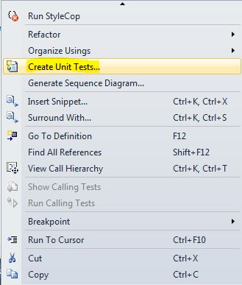
Generating unit test from source code
To generate a unit test
In the Visual Studio code editor, right-click a namespace, class, or method that we want to test, and select Create Unit Tests.
This displays the Create Unit Tests dialog box.
A tree structure displays the class and member hierarchy of the assembly that houses our code.
We can use this page to generate unit tests for any selection of those members or classes, and to choose a project into which we want the generated unit tests to be placed.
The code elements initially selected in the tree structure are the element that we right-clicked plus any child elements it contains. The selection is based on the current cursor position.

Slide 107
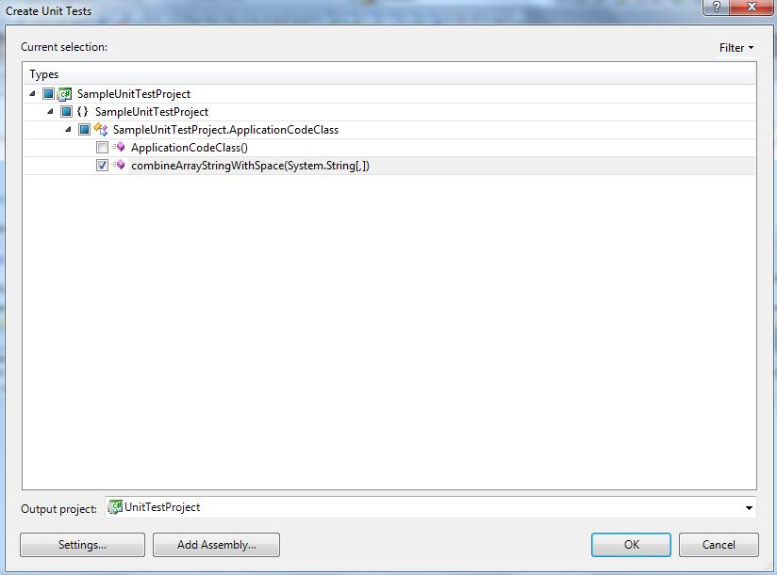
Generating unit test from source code

Slide 108
Generating unit test from source code
(Optional) Click Filter to change the contents of the displayed class and member hierarchy.
(Optional) Select additional code elements by checking their boxes.
(Optional) Click Settings to change configuration settings for this generation of tests. For example, we can change the default naming options for test files, classes, and methods to be generated. When finished, click OK.
Click OK.
If the test project for our solution does not already have a file that contains a test class, this action creates one and opens the file. The class is populated with an Initialize() method, a Cleanup() method, and methods to test the code elements we selected in steps 1 and 2. Solution Explorer displays the new test file in our test project.

Slide 109
Authoring a Unit Test
To create a unit test by typing it in
From the File menu, choose New Project. The New Project dialog displays.
Under Templates, choose the programming language we want to create unit test in and then choose the associated application type. For example, choose Visual C# , then choose class library test project from the available application types.
(Optional) In the Name textbox, enter the name we want to use for the Class library test project.
(Optional) Modify the path where we want to create the project by entering it in the Location textbox, or choosing the Browse button.
(Optional) In the Solution name textbox, enter that name we want to use for our solution.
Leave the Create directory for solution option selected and choose the OK button.

Slide 110
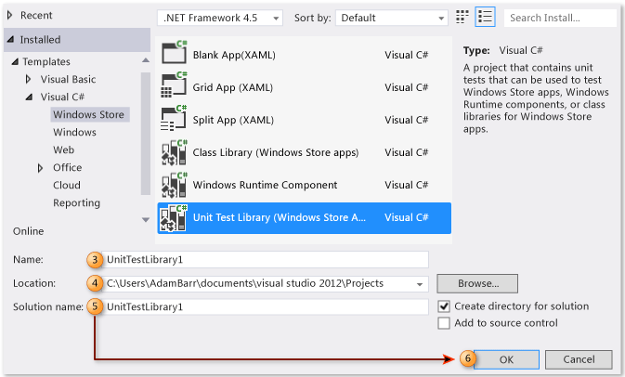
Authoring a Unit Test

Slide 111
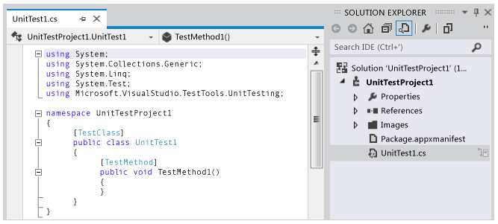
Authoring a Unit Test
Solution Explorer is populated with our new Windows Storeunit test project and the code editor displays the default unit test titled UnitTest1

Slide 112
Arrange/Assert
It is a pattern for arranging and formatting code in UnitTest methods
Arrange: Lists all necessary preconditions and inputs
Assert: Verifies the two specified objects are equal. The assertion fails if the objects are not equal.
Expected: The first object to compare. This is the object the unit test expects.
Actual: The second object to compare. This is the object the unit test produced.

Slide 113
Recap
In this chapter, we have learnt about:
Introduction to Web-Programming and Working with ASP.NET
Building ASP.NET pages
Performing Data Access
Building ASP.NET Application
Web services
Unit Testing

Slide 114
ASP.Net
You have successfully completed –
Learning on basics of ASP.Net

